Slide 1



CSE 2213:
Discrete Mathematics
Modified Slides (based on the source mentioned below):
Originals slides by Dr. Baek and Dr. Still, adapted by J. Stelovsky
Based on slides Dr. M. P. Frank and Dr. J.L. Gross
Provided by McGraw-Hill
1-1

Slide 2



Lecture 07
Chapter 2. Basic Structures
Sets
Set Operations

Slide 3


Sets so far…
 Previously…
 Literal set {a,b,c} and set-builder notation {x |P(x)}
 Basic properties: unordered, distinct elements
 infinite sets N, Z, Z⁺, Q, R
 Today
 ∈ relational operator, and the empty set ∅
 Venn diagrams
 Set relations =, ⊆, ⊇, ⊂, ⊃, ⊄, etc.
 Cardinality |S| of a set S
 Power sets P(S)
 Cartesian product S × T
 Set operators: ∪, ∩, -

Slide 4
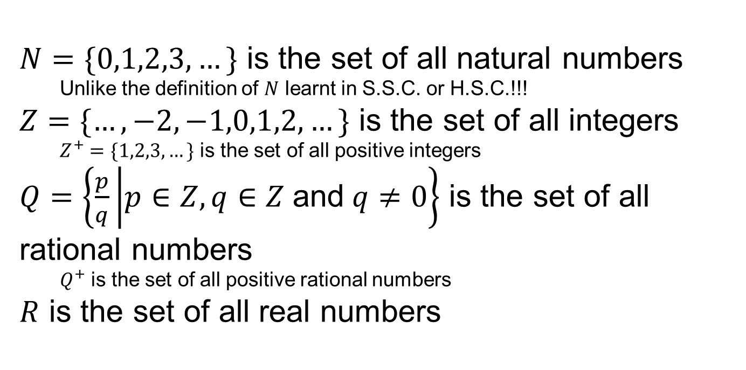
Some Important Sets
$N=\{0,1,2,3,…\}$ is the set of all natural numbers
Unlike the definition of $N$ learnt in S.S.C. or H.S.C.!!!
$Z=\{…,−2,−1,0,1,2,…\}$ is the set of all integers
$Z^{+}=\{1,2,3,…\}$ is the set of all positive integers
$Q=\left\{\frac{p}{q} | p∈Z,q∈Z \text{and} q≠0\right\}$ is the set of all rational numbers
$Q^{+}$ is the set of all positive rational numbers
$R$ is the set of all real numbers

Slide 5

Basic Set Relations: Member of
 x∈S (“x is in S”) is the proposition that object x
is an ∈lement or member of set S.
 e.g. 3 ∈ N,
a ∈ {x | x is a letter of the alphabet}
 Can define set equality in terms of ∈ relation:
∀S,T: S = T ↔ [∀x (x∈S ↔ x∈T)]
“Two sets are equal iff they have all the same members.”
 x∉S ≡ ¬(x∈S) “x is not in S”

Slide 6

The Empty Set
 ∅ (“null”, “the empty set”) is the unique set that contains no elements whatsoever.
 ∅ = { } = {x | False}
 No matter the domain of discourse, we have the axiom ¬∃x: x∈∅.
 { } ≠ {∅} = { { } }
 {∅} it isn’t empty because it has ∅ as a member!

Slide 7

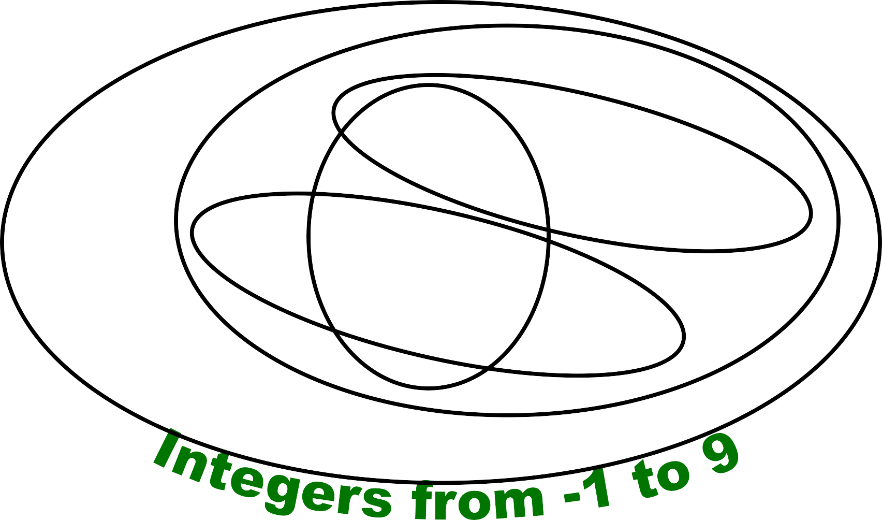



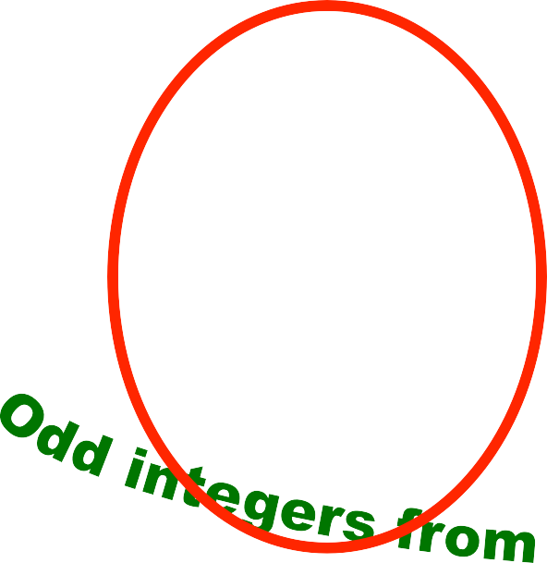































































































Venn Diagrams
U

Slide 8

Subset and Superset
 S⊆T (“S is a subset of T ”) means that every element of S is also an element of T.
 S⊆T ≡ ∀x (x∈S → x∈T)
 ∅⊆S, S⊆S
 (“S is a superset of T ”) means T⊆S
 Note (S = T) ≡ (S⊆T ∧ T⊆S)
≡ ∀x(x∈S → x∈T) ∧ ∀x(x∈T → x∈S)
≡ ∀x(x∈S ↔ x∈T)
 S⊆T means ¬(S⊆T), i.e. ∃x(x∈S ∧ x∉T)

Slide 9
Proper (Strict) Subsets &
Supersets
 S⊂T (“S is a proper subset of T ”) means that
S⊆T but T⊆S. Similar for S ⊃T.
 Example:
{1, 2} ⊂ {1, 2, 3}
S
T
Venn Diagram of S⊂T

Slide 10



Sets Are Objects, Too!
 The objects that are elements of a set may
themselves be sets.
 Example:
Let S = {x | x ⊆ {1, 2, 3}} then S = { ∅,
{1}, {2}, {3},
{1, 2}, {1, 3}, {2, 3},
{1, 2, 3} }
 Note that 1 ≠ {1} ≠ {{1}} !!!!

Slide 11


Cardinality and Finiteness
 |S| (read “the cardinality of S”) is a measure of how many different elements S has.
 E.g., |∅| = 0, | {1, 2, 3} | = 3, | {a, b} | = 2,
| { {1, 2, 3}, {4, 5} } | =
 If |S| ∈ N, then we say S is finite.
Otherwise, we say S is infinite.
 What are some infinite sets we’ve seen?
N, Z, Q, R

Slide 12
The Power Set Operation
 The power set P(S) of a set S is the set of all subsets of S. P(S) = {x | x⊆S}.
 Examples
 P({a, b}) = { ∅, {a}, {b}, {a, b} }
 S = {0, 1, 2}
P(S) = {∅, {0}, {1}, {2}, {0, 1}, {0, 2}, {1, 2},
{0, 1, 2}}
 P(∅) = {∅}
 P({∅}) = {∅, {∅}}
 Note that for finite S, |P(S)| = 2^{|S|}.
 It turns out ∀S (|P(S)| > |S|), e.g. |P(N)| > |N|.

Slide 13
Cartesian Products of Sets
 For sets A and B, their Cartesian product denoted by A × B, is the set of all ordered pairs (a, b), where a∈A and b∈B. Hence,
A × B = { (a, b) | a∈A ∧ b∈B }.
 E.g. {a, b} × {1, 2}
= { (a, 1), (a, 2), (b, 1), (b, 2) }
 Note that for finite A, B, |A × B| = |A||B|.
 Note that the Cartesian product is not
commutative: i.e., ¬∀A,B (A × B = B × A).
 Extends to A₁ × A₂ × … × A_{n}
= {(a₁, a₂, …, a_{n}) | a_{i} ∈ A_{i} for i = 1, 2,…, n}

Slide 14
The Union Operator
 For sets A and B, their union A∪B is the set containing all elements that are either in A, or (“∨”) in B (or, of course, in both).
 Formally, ∀A,B: A∪B = {x | x∈A ∨ x∈B}.
 Note that A∪B is a superset of both A and B
(in fact, it is the smallest such superset):
∀A,B: (A∪B ⊇ A) ∧ (A∪B ⊇ B)

Slide 15
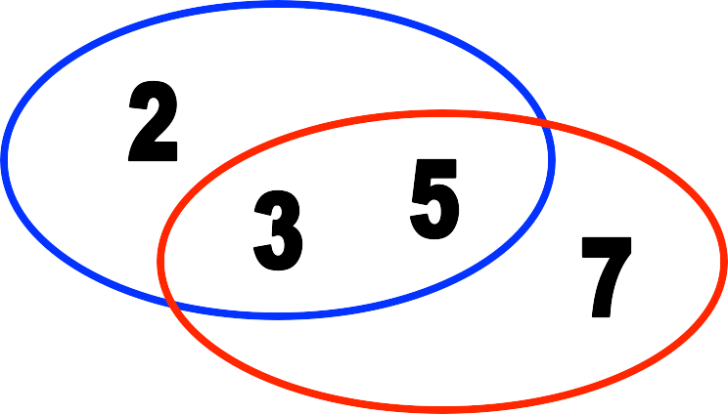



Union Examples
 {a, b, c} ∪ {2, 3} = {a, b, c, 2, 3}
 {2, 3, 5} ∪ {3, 5, 7} = {2, 3, 5, 3, 5, 7}
= {2, 3, 5, 7}
Let A and B be sets. The union of the sets A and B, denoted by A ∪ B, is the set that contains those elements that are either in A or in B, or in both.

Slide 16
The Intersection Operator
 For sets A and B, their intersection A∩B is the set containing all elements that are simultaneously in A and (“∧”) in B.
 Formally, ∀A,B: A∩B = {x | x∈A ∧ x∈B}.
 Note that A∩B is a subset of both A and B (in fact it is the largest such subset):
∀A,B: (A∩B ⊆ A) ∧ (A∩B ⊆ B)

Slide 17
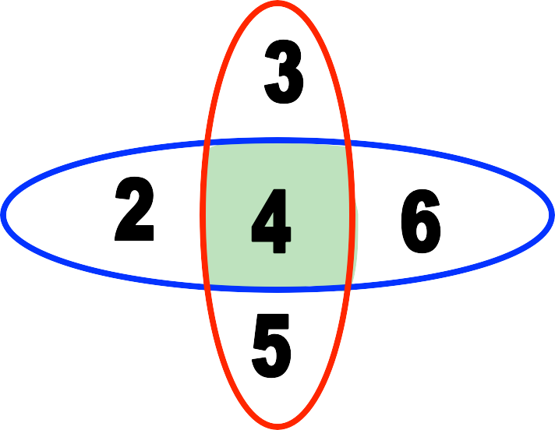
Intersection Examples
 {a, b, c} ∩ {2, 3} = ∅
 {2, 4, 6} ∩ {3, 4, 5} = {4}
Think “The intersection of Madani Ave. and Bir Uttam Rafiqul Islam Ave. is just that part of the road surface that lies on both streets.”

Slide 18
Disjointedness
 Two sets A, B are called disjoint (i.e., unjoined) iff their intersection is empty. (A ∩ B = ∅)
Help, I’ve been disjointed!
 Example: the set of even integers is disjoint with the set of odd integers.

Slide 19
Inclusion-Exclusion Principle
 How many elements are in A∪B?
|A∪B| = |A| + |B| - |A∩B|
 Example: How many students in the class major in Computer Science or Physics?
 Consider set E = C ∪ P,
C = {s | s is a Computer Science major}
P = {s | s is a Physics major}
 Some students are joint majors!
|E| = |C ∪ P | = |C| + | P | - |C ∩ P |

Slide 20
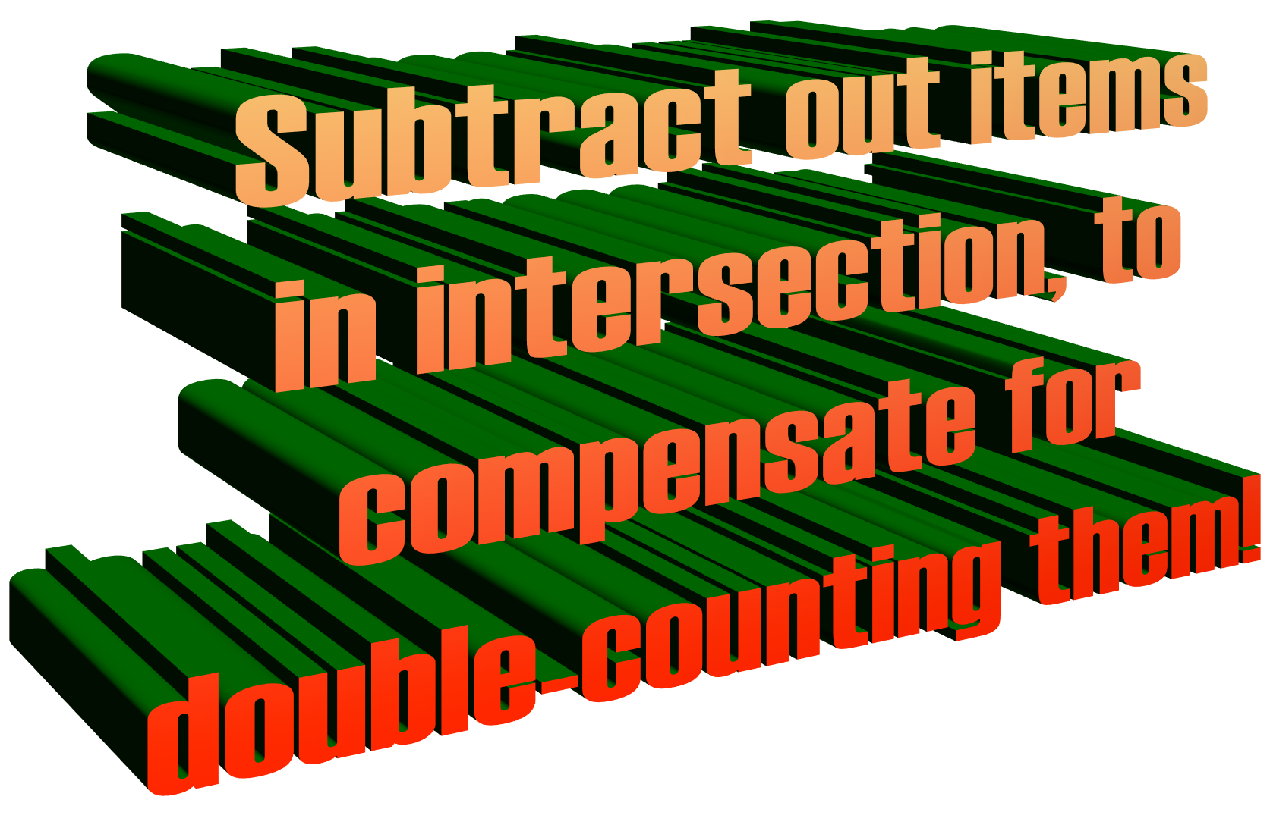
Inclusion-Exclusion Principle
 How many elements are in A∪B?
|A∪B| = |A| + |B| - |A∩B|
 Example: How many students in the class major in Computer Science or Physics?
 Consider set E = C ∪ P,
C = {s | s is a Computer Science major}
P = {s | s is a Physics major}
 Some students are joint majors!
|E| = |C ∪ P | = |C| + | P | - |C ∩ P |

Slide 21
Set Difference
 For sets A and B, the difference of A and B, written A - B, is the set of all elements that are in A but not B.
 Formally:
A - B = {x | x∈A ∧ x∉B}
= {x | ¬(x∈A → x∈B)}
 Also called:
The complement of B with respect to A.

Slide 22

Set Difference: Venn Diagram
 A − B
is what’s left after B “takes a bite out of A”
Chomp!
Set
A - B
Set A
Set B

Slide 23
Set Difference Examples
 {1, 2, 3, 4, 5, 6} - {2, 3, 5, 7, 9, 11} =
{1, 4, 6}
 Z - N = {… , −1, 0, 1, 2, … } - {0, 1, … }
= {x | x is an integer but not a natural #}
= {… , −3, −2, −1}
= {x | x is a negative integer}

Slide 24
Set Complements
 The universe of discourse (or the domain) can itself be considered a set, call it U.
 When the context clearly defines U, we say that for any set A ⊆ U, the complement of A, written as A, is the complement of A with respect to U, i.e., it is U - A.
 E.g., If U = N,
{3, 5} = {0,1, 2, 4, 6, 7,...}

Slide 25
More on Set Complements
 An equivalent definition, when U is obvious:
A ={x | x ∉ A}
A
A
A
U

Slide 26
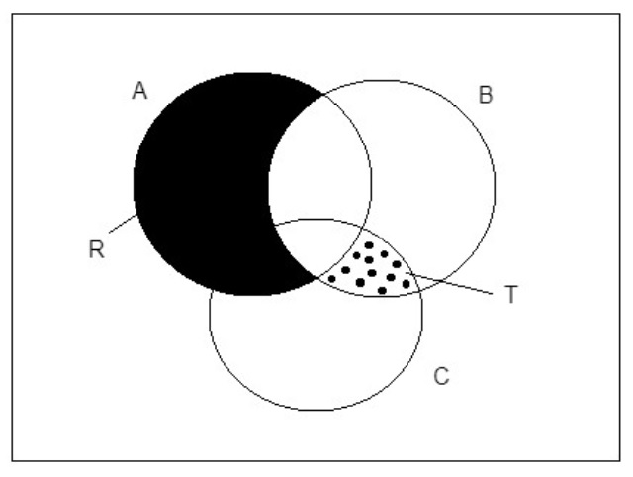
Exercise
What is R?
What is T?
R = A - B
T = (B ∩ C ) - A

